Slide 1
CS5551 Advanced Software Engineering
Introduction to ASE

Slide 2
CS5551 Advanced Software Engineering
Class Hours:
T/Th 5:30 – 6:45PM,
MNLC-Rm 452
Coordinator: Dr. Yugyung Lee
Office HR: T/Th 4:00 – 5:00PM
Instructor: Raj Anantharaman
Office HR: T 6:45 – 7:45 PM and by appointment.
TAs:
Ruthvic Punyamurtula
Sravanthi Gogadi
Bhargavi Nadendla
Assessment Plan
Journal Club | Presentation | 5%
Hackathon (Group) | Team of 3-4 students | 5%
Project (Group) | Presentation/Demo | 35%
 | Proposal & Project Reports
 | Technical Contribution
Exam (Individual) | 2 Exams | 20%
Lab/ICP (Team – pair of students) | 3 Lab Assignments & 10 ICPs | 30%
Participation & Active Learning (Individual) |  | 5%
Problem Sets | 6 Problem Sets | Extra Points
Total |  | 100%

Slide 3
Journal Club
Module# | Date | Topic
Module 1: Web/Mobile Client & Client Side Mashup | 8/21/2018 | NBA
 | 8/28/2018 | Paper 1 (Team 1: Presenter, Team 2: Critique/Discussion)
 | 9/4/2018 | Paper 2 (Team 3: Presenter, Team 4: Critique/Discussion)
 | 9/11/2018 | Paper 3 (Team 5: Presenter, Team 6: Critique/Discussion)
 | 9/18/2018 | Paper 4 (Team 7: Presenter, Team 8: Critique/Discussion)
 | 9/25/2018 | Paper 5 (Team 9: Presenter, Team 10: Critique/Discussion)
 | 10/2/2018 | Paper 6 (Team 11: Presenter, Team 12: Critique/Discussion)
 | 10/9/2018 | Exam-1 (Client: Web/App/Mashup Style, Paper 1 - 6)
Module 2: Web/Cloud Server & Server Side Mashup | 10/16/2018 | Paper 7 (Team 2: Presenter, Team 1: Critique/Discussion)
 | 10/23/2018 | Paper 8 (Team 4: Presenter, Team 3: Critique/Discussion)
 | 10/30/2018 | Paper 9 (Team 6: Presenter, Team 5: Critique/Discussion)
 | 11/6/2018 | Paper 10 (Team 8: Presenter, Team 7: Critique/Discussion)
 | 11/13/2018 | Paper 11 (Team 10: Presenter, Team 9: Critique/Discussion)
 | 11/15/2018 | Paper 12 (Team 12: Presenter, Team 11: Critique/Discussion)
 | 12/11/2018 | Final Exam - Thursday, May 11, 10:30 a.m.-12:30 p.m.
https://docs.google.com/spreadsheets/d/1H70l0QVUifcyMqOqfnRXdW34xEWIt66GrY2xt5X7n_c/edit#gid=1247929128

Slide 4
Exam & Problem Sets
Module# | Date | Topic | Problem Sets
Module 1: Web/Mobile Client & Client Side Mashup | 8/21/2018 | Lesson 1: Introduction to Advanced Software Engineering
 | 8/28/2018 | Lesson 2: Project Management & Process Model
 | 9/4/2018 | Lesson 3: Client: Mobile Web/App/Mashup Style & UML Design | PS-1 (Deadline: 9/4)
 | 9/11/2018 | Lesson 4: Client: Mobile Web/App/Mashup Style & UML Design
 | 9/18/2018 | Lesson 5: Client: Mobile Web/App/Mashup Style & UML Design
 | 9/25/2018 | Lesson6: Mashup Style & Testing | PS-4 (Deadline: 9/25)
 | 10/9/2018 | Exam-1 (Client: Mobile App/Mashup Style & UML)
 | 10/16/2018 | Lesson 8: MEAN Stack | PS-3 (Deadline: 10/16)
 | 10/23/2018 | Lesson 9: Server: Web/Cloud Server/Mashup Style & Testing
 | 10/30/2018 | Lesson 10: Server: Web/Cloud Server/Mashup Style & Testing | PS-4 (Deadline: 10/30)
 | 11/1/2018 | Hackathon Kick-Off Meeting, 5:30 - 6:45PM
 | 11/6/2018 | Lesson 11: Server: Web/Cloud Server/Mashup Style & Testing
Module 2: Web/Cloud Server & Server Side Mashup | 11/8/2018 | Hackathon Grand Finale, 5:30 - 7:30PM
 | 11/13/2018 | Lesson 12: Design Pattern (1) | PS-5 (Deadline: 11/13)
 | 11/15/2018 | Lesson 13: Design Pattern (2)
 | 11/27/2018 | Lesson 14: Design Pattern (3)
 | 11/29/2018 | Lesson 15: Architecture Style & Design Pattern | PS-6 (Deadline: 11/29)
 | 12/4/2018 | Project Demo
 | 12/6/2018 | Project Demo
 | 12/11/2018 | Final Exam Thursday, Dec 11, 5:45 p.m.-7:45 p.m.

Slide 5
Tutorial/Lab Plan (8/23 – 10/25)
Tutorial 1 | 8/23/2018 | Introduction and Installation of Tools | ICP 1 Submission (8/24)
Tutorial 2 | 8/30/2018 | Front End development using HTML5, CSS3, JS, BootStrap, AngularJS, AJAX | ICP 2 Submission (8/31)
Tutorial 3 | 9/6/2018 | Single Page Application development with Webservices Mashup | ICP 3 Submission (9/7)
Tutorial 4 | 9/13/2018 | Understanding Android Programming | ICP 4 Submission (9/14) | Lab 1 Assignment (Deadline: 9/14)
Tutorial 5-1 | 9/20/2018 | Advanced Android Programming using Phone Hardware Features like Camera and Location services | ICP 5 Submission (9/21)
Tutorial 5-2 |  | Bringing Vitrual Reality to Android Development
Tutorial 6-1 | 9/27/2018 | Bringing Augmented Reality to Android Development with vuforia SDK | ICP 6 Submission (9/28)
Tutorial 6-2 |  | Understanding Ionic Application Development and testing (unit/performance)
Tutorial 7 | 10/4/2018 | Advanced Ionic Programming using Camera plugin and Firebase as a service | ICP 7 Submission (10/5)
Tutorial 8 | 10/11/2018 | Introduction to MEAN Application Development | ICP 8 Submission (10/12) | Lab 2 Assignment (Deadline: 10/15)
Tutorial 9 | 10/18/2018 | Connecting MEAN application to MongoDB | ICP 9 Submission (10/19)
Tutorial 10 | 10/25/2018 | Social Network Data Analysis on Node Deploying Mean App to Heroku Cloud and | ICP 10 Submission (10/26) | Lab 3 Assignment (Deadline: 10/31)

Slide 6
Tutorial/Lab Plan (8/23 – 10/25)
Feedback/attendance: submit the form at the end of each tutorial https://goo.gl/forms/RzHHUiNWUsiI8j3n1
https://docs.google.com/spreadsheets/d/1H70l0QVUifcyMqOqfnRXdW34xEWIt66GrY2xt5X7n_c/edit#gid=742202525

Slide 7
Project Plan (1/17 – 5/5)
Up to 4 students per team
(Special individual teams)
Project Domain:
Healthcare Informatics and/or IT
Digital Marketing
Agriculture
Animal Health and Life Sciences
Engineering
Telecommunication
Proposal | 8/31/2018
Plan & Increment 1 | 9/28/2018
Increment 2 | 10/26/2018
Increment 3 | 11/30/2018
Project Video/PPT | 12/3/2018
Project Presentation | 12/3 & 12/5
Final Submission | 12/7/2018
https://docs.google.com/spreadsheets/d/1H70l0QVUifcyMqOqfnRXdW34xEWIt66GrY2xt5X7n_c/edit#gid=154683267

Slide 8
Let’s try something!
https://play.kahoot.it/#/k/a4adb2c6-2d14-43b9-9dc0-2d618ec9fefc

Slide 9
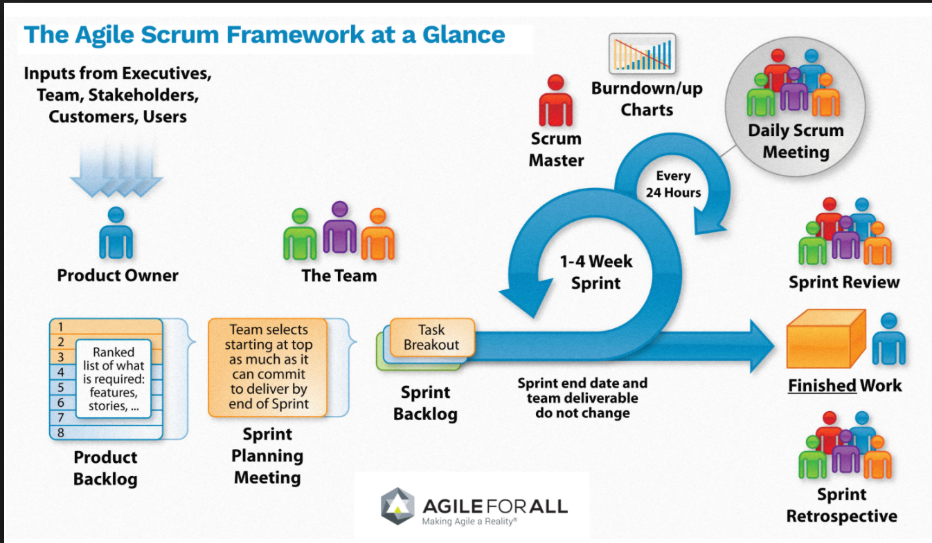
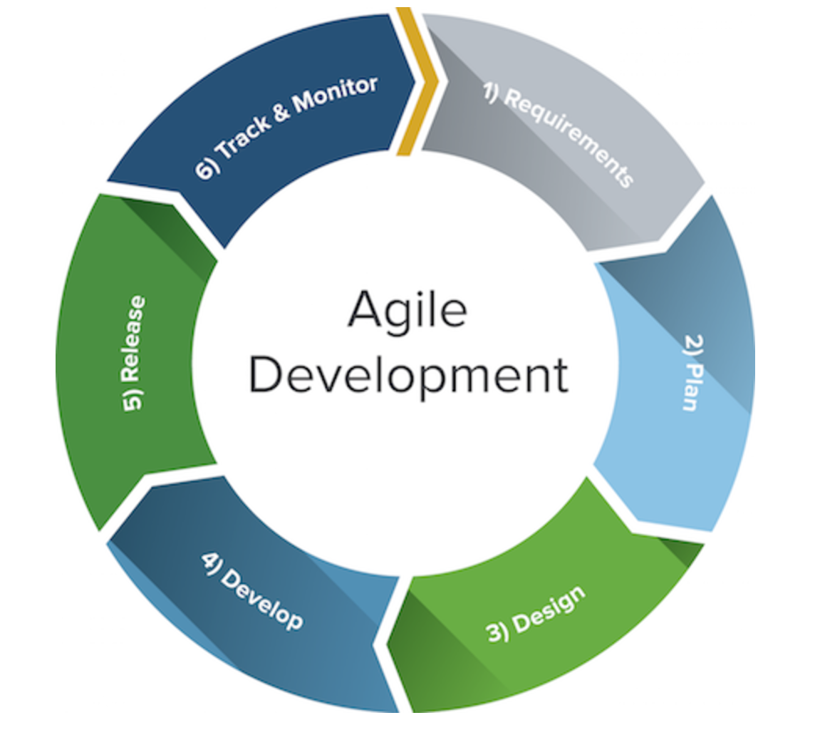
Agile Process Model
https://www.smartsheet.com/agile-vs-scrum-vs-waterfall-vs-kanban
http://agileforall.com/resources/introduction-to-agile/

Slide 10
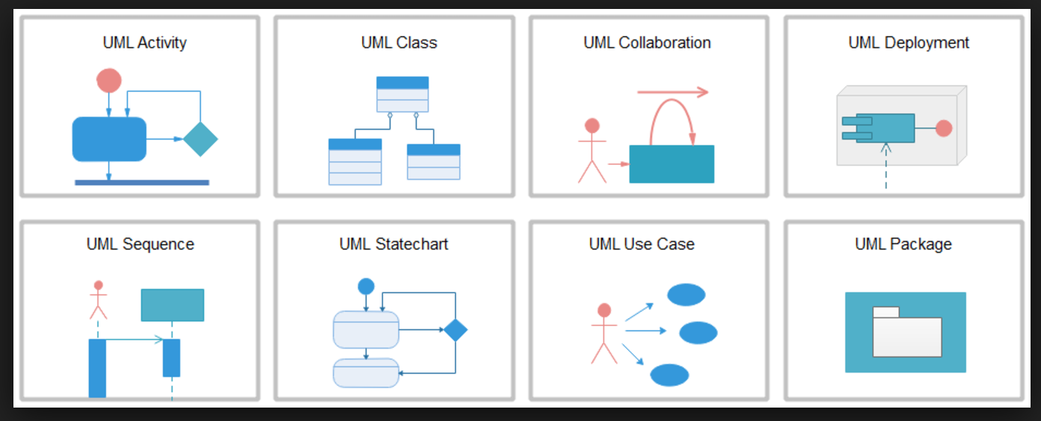
UML: Unified Modeling Language

Slide 11
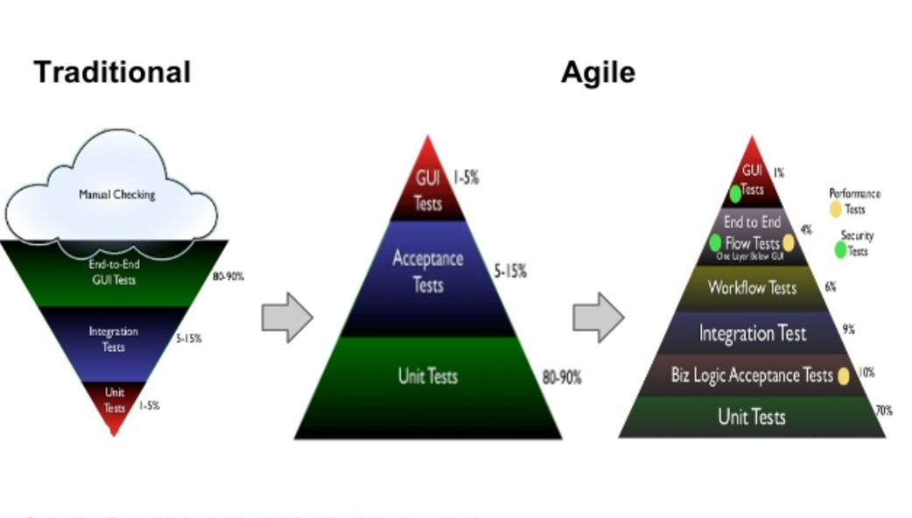
Testing
https://blogs.agilefaqs.com/2011/02/01/inverting-the-testing-pyramid/ - Naresh Jain

Slide 12
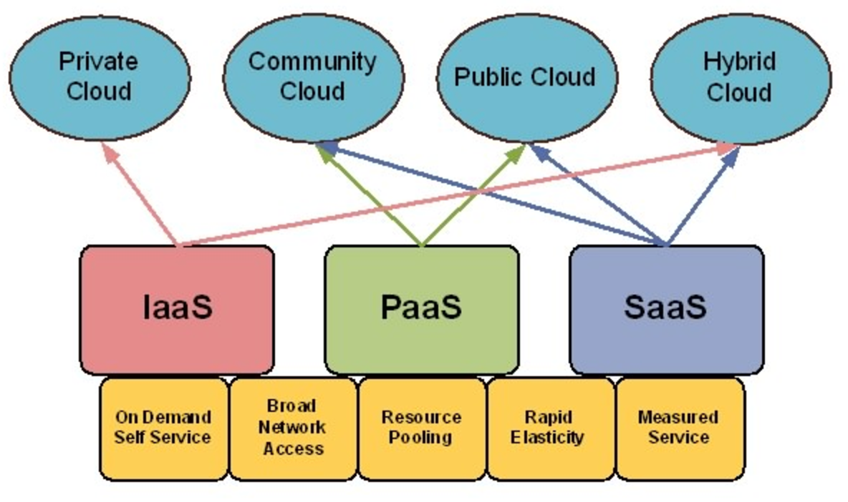
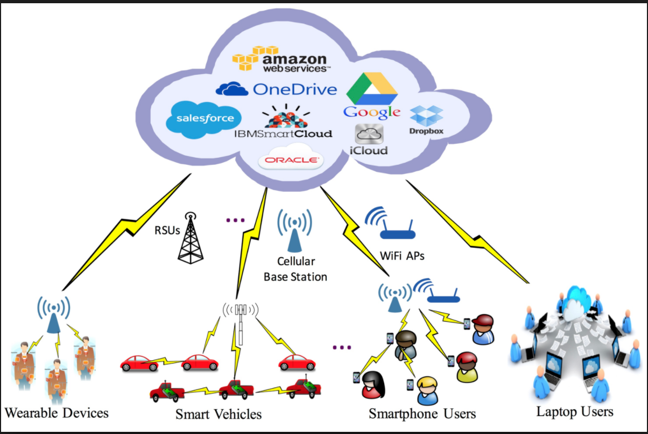
Cloud Computing
http://bbcr.uwaterloo.ca/SubGroup/security_bbcr/

Slide 13
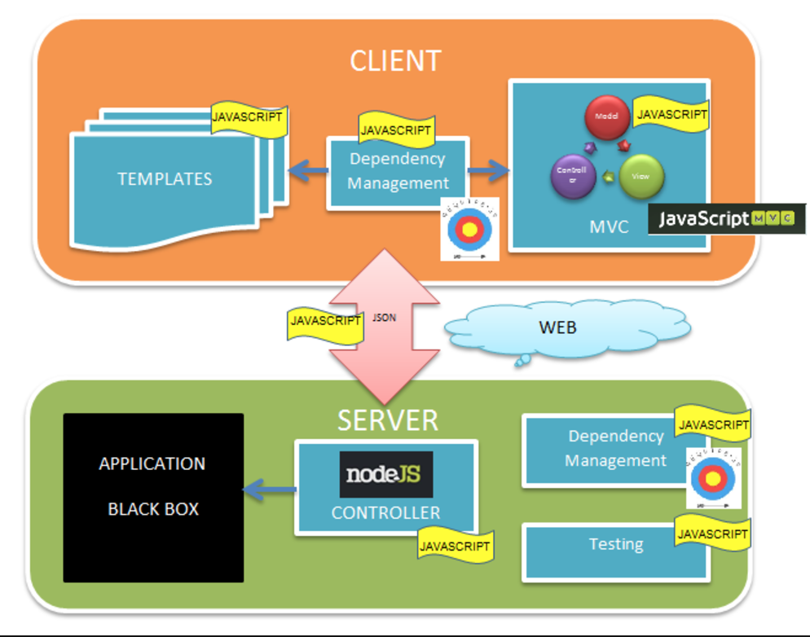
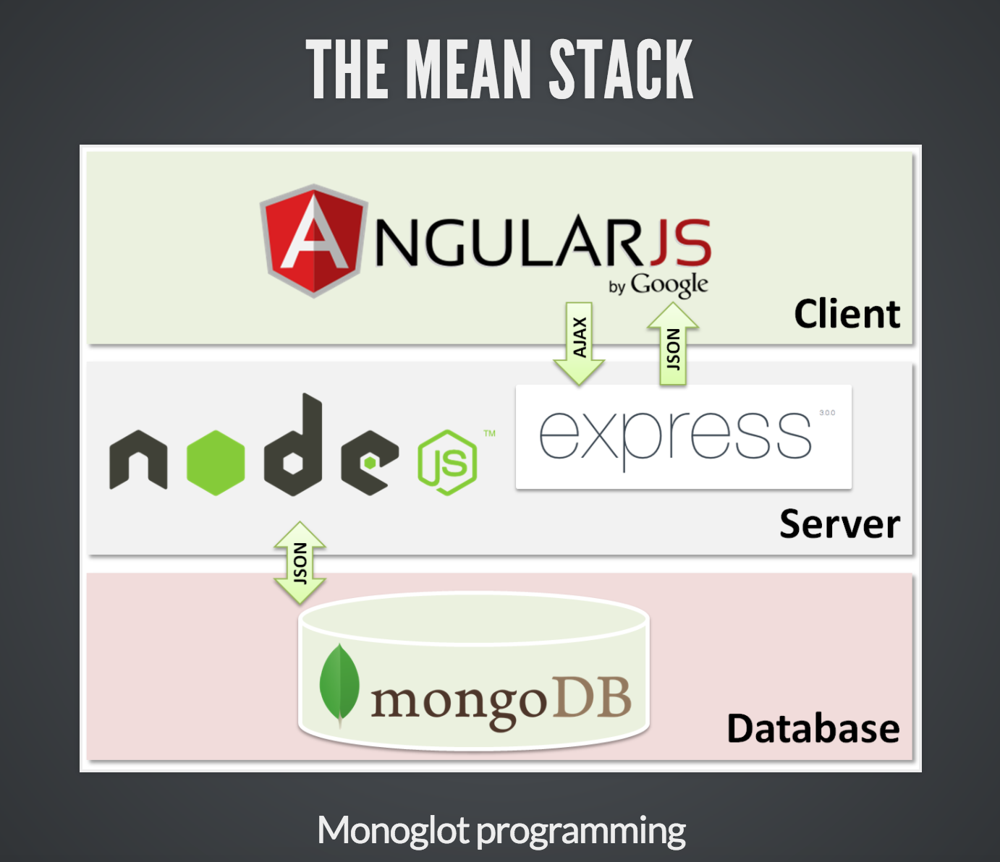
JavaScript Everywhere
https://dzone.com/articles/javascript-javascript
http://joaopsilva.github.io/talks/End-to-End-JavaScript-with-the-MEAN-Stack/

Slide 14
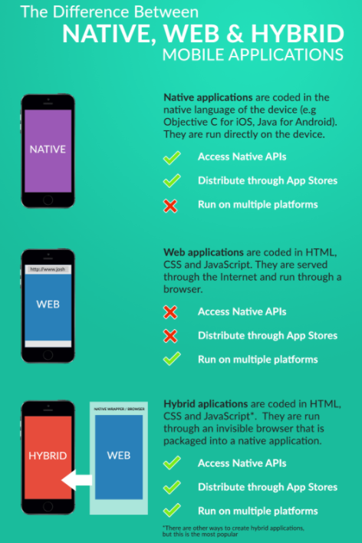
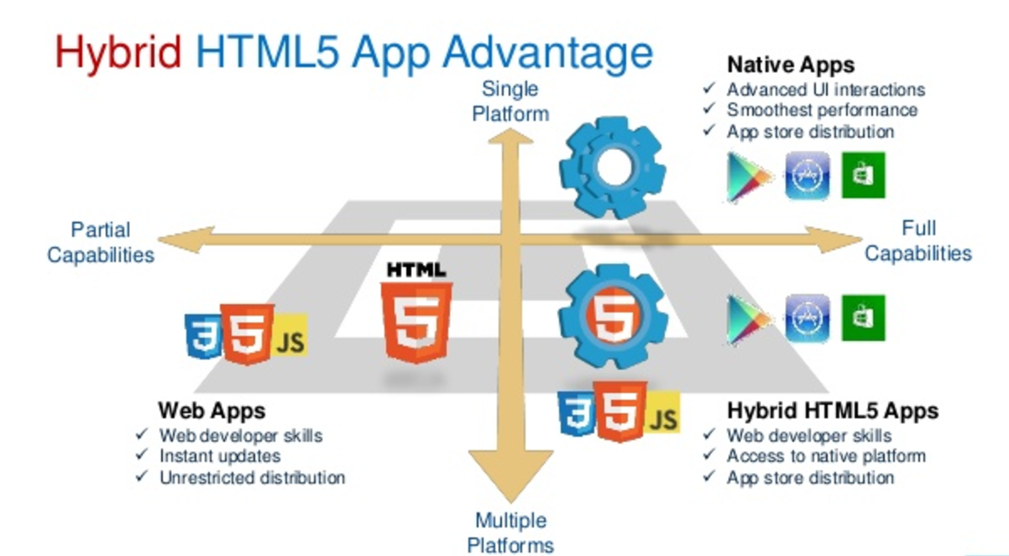
Mobile Apps
http://www.slideshare.net/IntelSoftware/the-power-and-pain-of-cordova-plugins

Slide 15
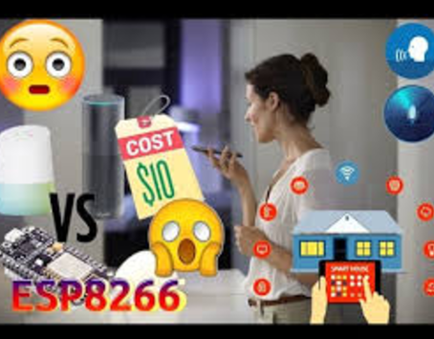
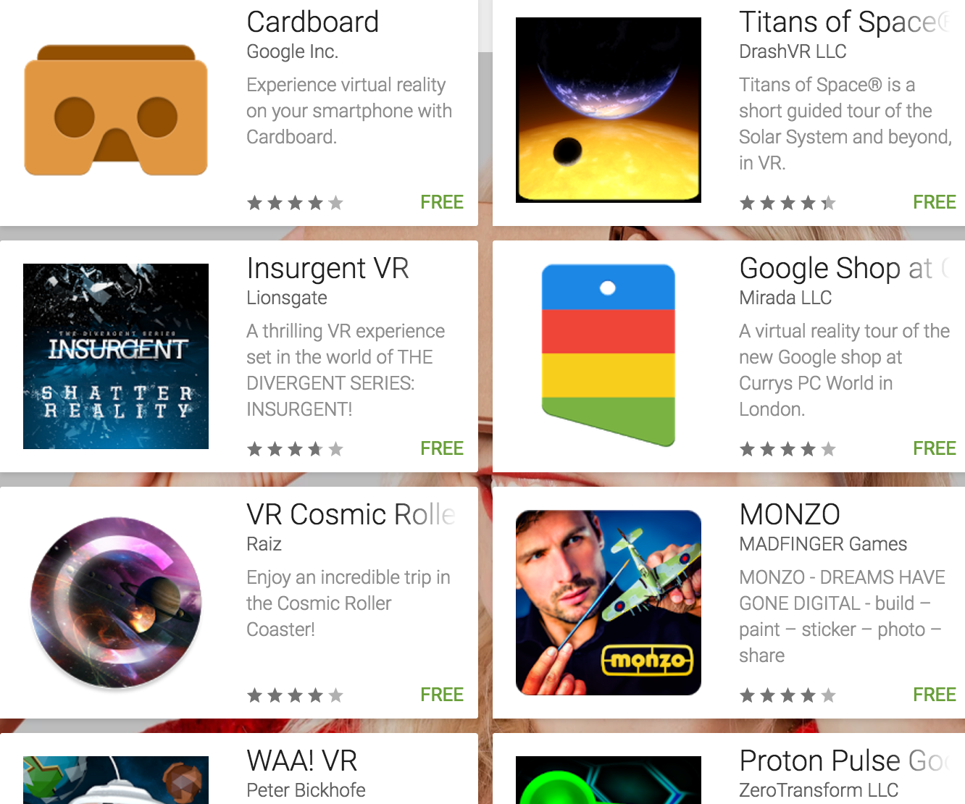
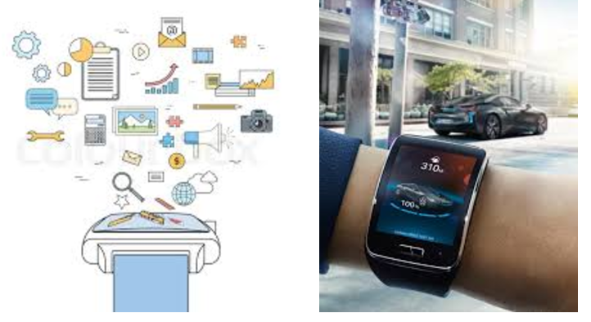
Project Ideas
Google Home Applications
Google Cardboard Applications
http://voicelabs.co/2016/09/12/can-anyone-develop-new-skills-for-the-upcoming-google-assistant-like-for-alexa-and-if-yes-how/
Smart Watch Applications
https://youtu.be/71kmFOka84U
https://youtu.be/tHJYbmS1kL0

Slide 16
CS5551 Projects, Fall 2016
Team 15 | Small Oven | https://drive.google.com/file/d/0BwU52vVsOahFVUNuV29yOVBjZ2M/view?usp=sharing | https://www.youtube.com/watch?v=kT3NMsQ3k2I
Team 5 | EduFun | https://www.dropbox.com/s/1ikpy7gg9p5plbk/ASE%20Project%20ppt.pptx?dl=0 | https://www.youtube.com/watch?v=484kb2tn-KI&feature=youtu.be
Team 1 | Pocket Manager | https://docs.google.com/viewer?url=https://github.com/dwk894/CS5551FS16_Pocket_Manager/raw/master/Documentation/Project_Presentation_Slides/COMP-SCI_5551_(FS16)_-_Project_Presentation_-_Slides_-_PDF.pdf | https://www.youtube.com/watch?v=jDlG3VnnlKg

Slide 17
Project Ideas
College Enquiry Chat Bot
Stream Analysis For Career Choice Aptitude Tests
Product Review Analysis For Genuine Rating
Android Smart City Traveler
Artificial Intelligence Dietician
Heart Disease Prediction Project
Smart Health Consulting Project
Banking Bot Project
Sentiment Based Movie Rating System
Online AI Shopping With M-Wallet System
Question paper generator system
Student Information Chatbot Project
Website Evaluation Using Opinion Mining
Android Attendance System
Intelligent Tourist System Project
AI Desktop Partner
Intelligent Chat Bot
Stock Market Analysis and Prediction
Automatic Answer Checker
http://nevonprojects.com/artificial-intelligence-projects/

Slide 18
Project Ideas
Online Mobile Recharge Portal Project
Detecting E Banking Phishing Websites Using Associative Classification
Vehicle Tracking Using Driver Mobile Gps Tracking
Sentiment Analysis for Product Rating
Fingerprint Based ATM System
Image Encryption Using AES Algorithm
Image Encryption Using Triple DES
Extended AES with Custom Configurable Encryption
E Commerce Product Rating Based On Customer Review Mining
Image Steganography With 3 Way Encryption
Canteen Automation System
Engineering College Automation and Scheduling System
Fingerprint Voting System Project
Employee Hourly Attendance By Barcode Scan
….
Android Based Universal Ticketing Project
Smart Health Prediction Using Data Mining
ERP System For Institutes
Efficient Doctor Patient Portal
Online Bookstore System On Cloud Infrastructure
Cloud Based Online Blood Bank System
Cloud Based Local Train Ticketing System
Cloud Based Bus Pass System
Cloud Based Career Guidance System
Android Bluetooth Chat
Bus Pass with Barcode Card scan
Bus Pass with webcam Scan
Employee attendance System By Qr Scan
Online Printed T-Shirt Designing
….
http://nevonprojects.com/project-ideas/software-project-ideas/

